Slide 1
Georgia Tech's Computational Photography Class
Portfolio
Hieu Nguyen
hieu@gatech.edu
https://cs6475.wordpress.com/2015-fall/

Slide 2
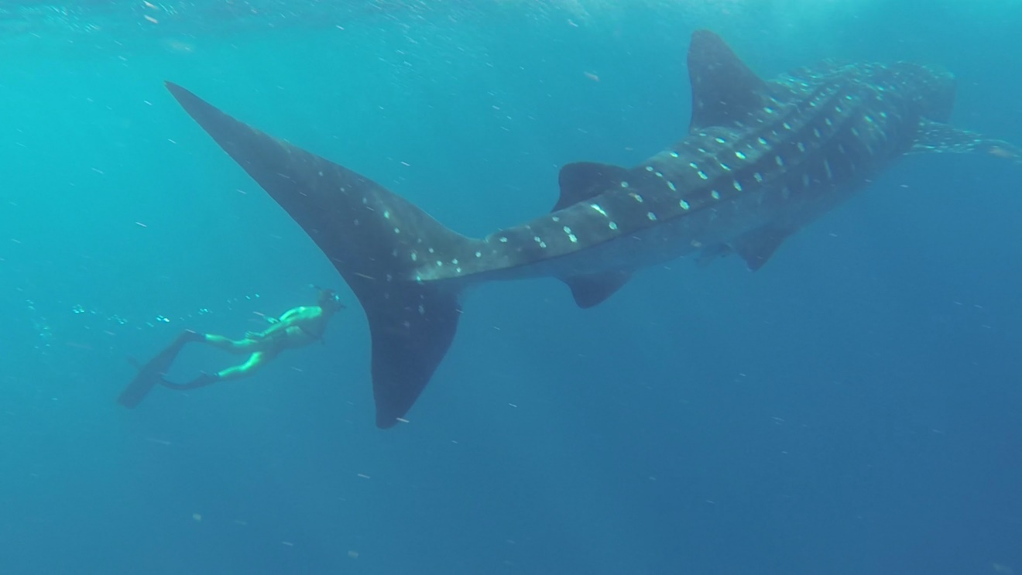
Assignment #1: A Photograph is a Photograph
“Deep Pursuit”
This photograph was shot off the coast of Isla Mujeres in Cancun, Mexico with a GoPro Hero3 camera

Slide 3
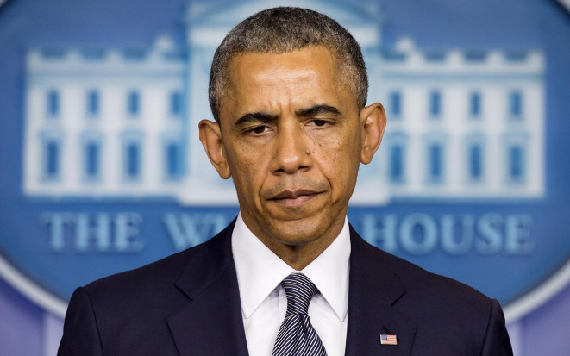
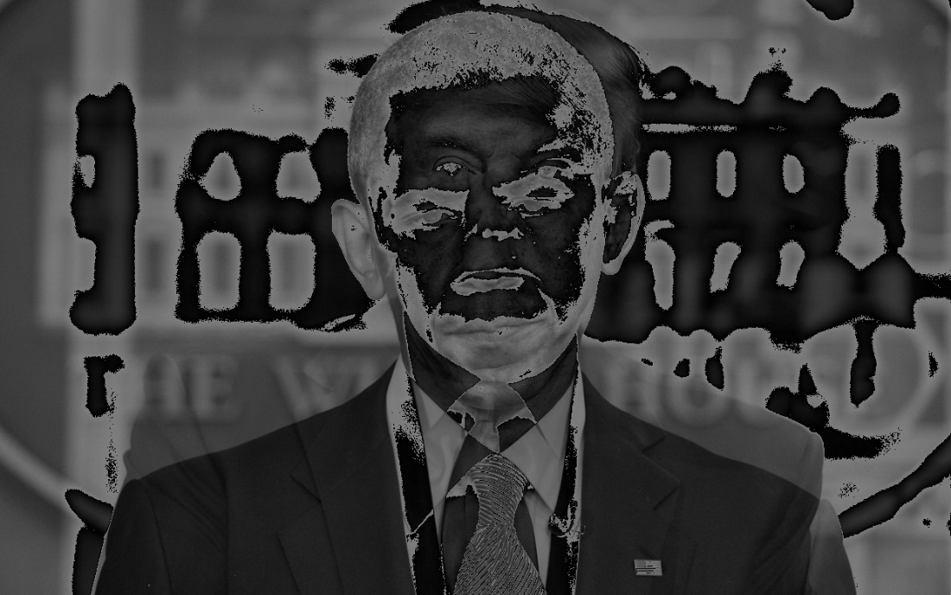

Assignment #2: Image I/O
Input:
Output:
averageTwoImages()

Slide 4
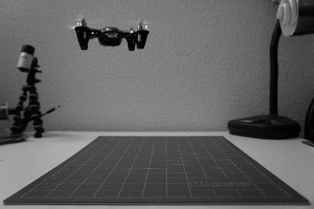
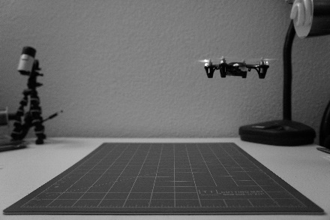
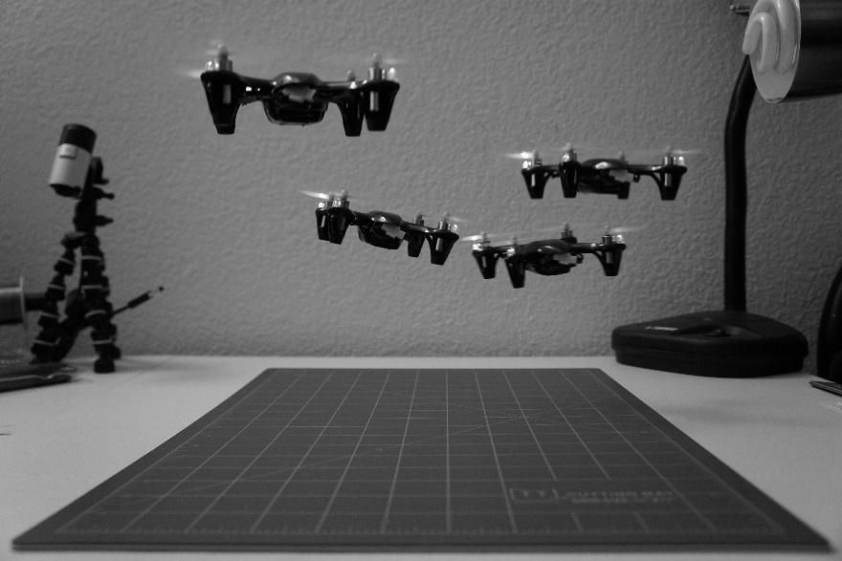
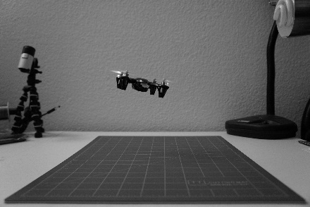
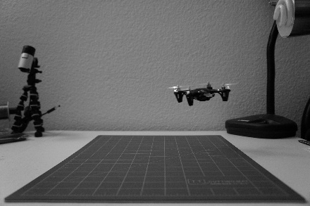
Assignment #3: Epsilon Photography
1
3
2
4
A quad of quads! This epsilon photograph captures a single quadcopter in motion. By overlaying 4 images of the quad in different positions in the three dimensional space, it appears as if there is a swarm!

Slide 5
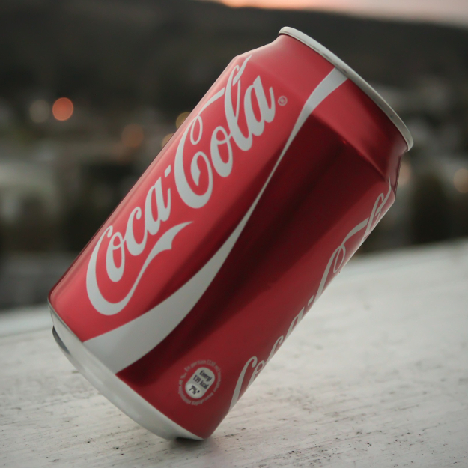


Assignment #4: Gradients and Edges
Input
Black/White Gradient
(threshold=50)
Canny Edge Detection (thr1=900, thr2=3200, apSz=5)

Slide 6
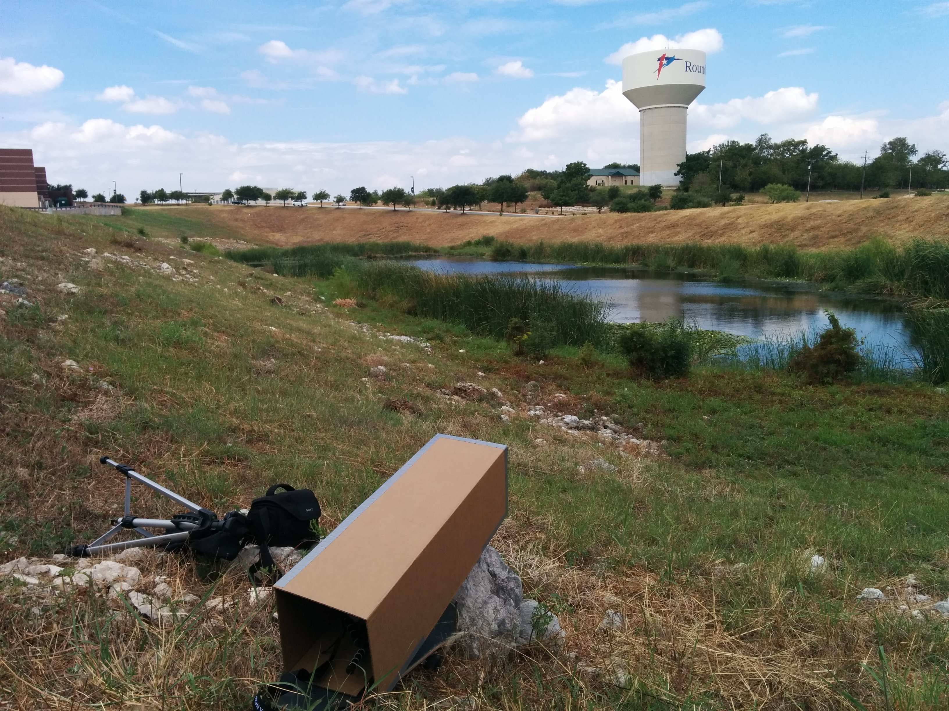
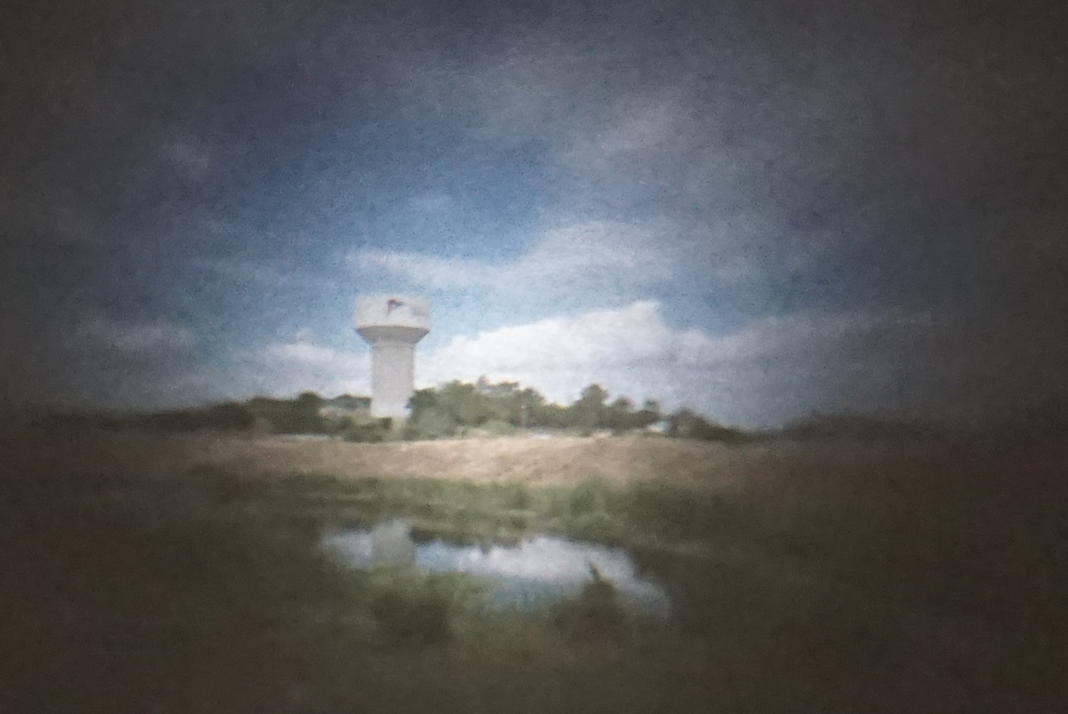
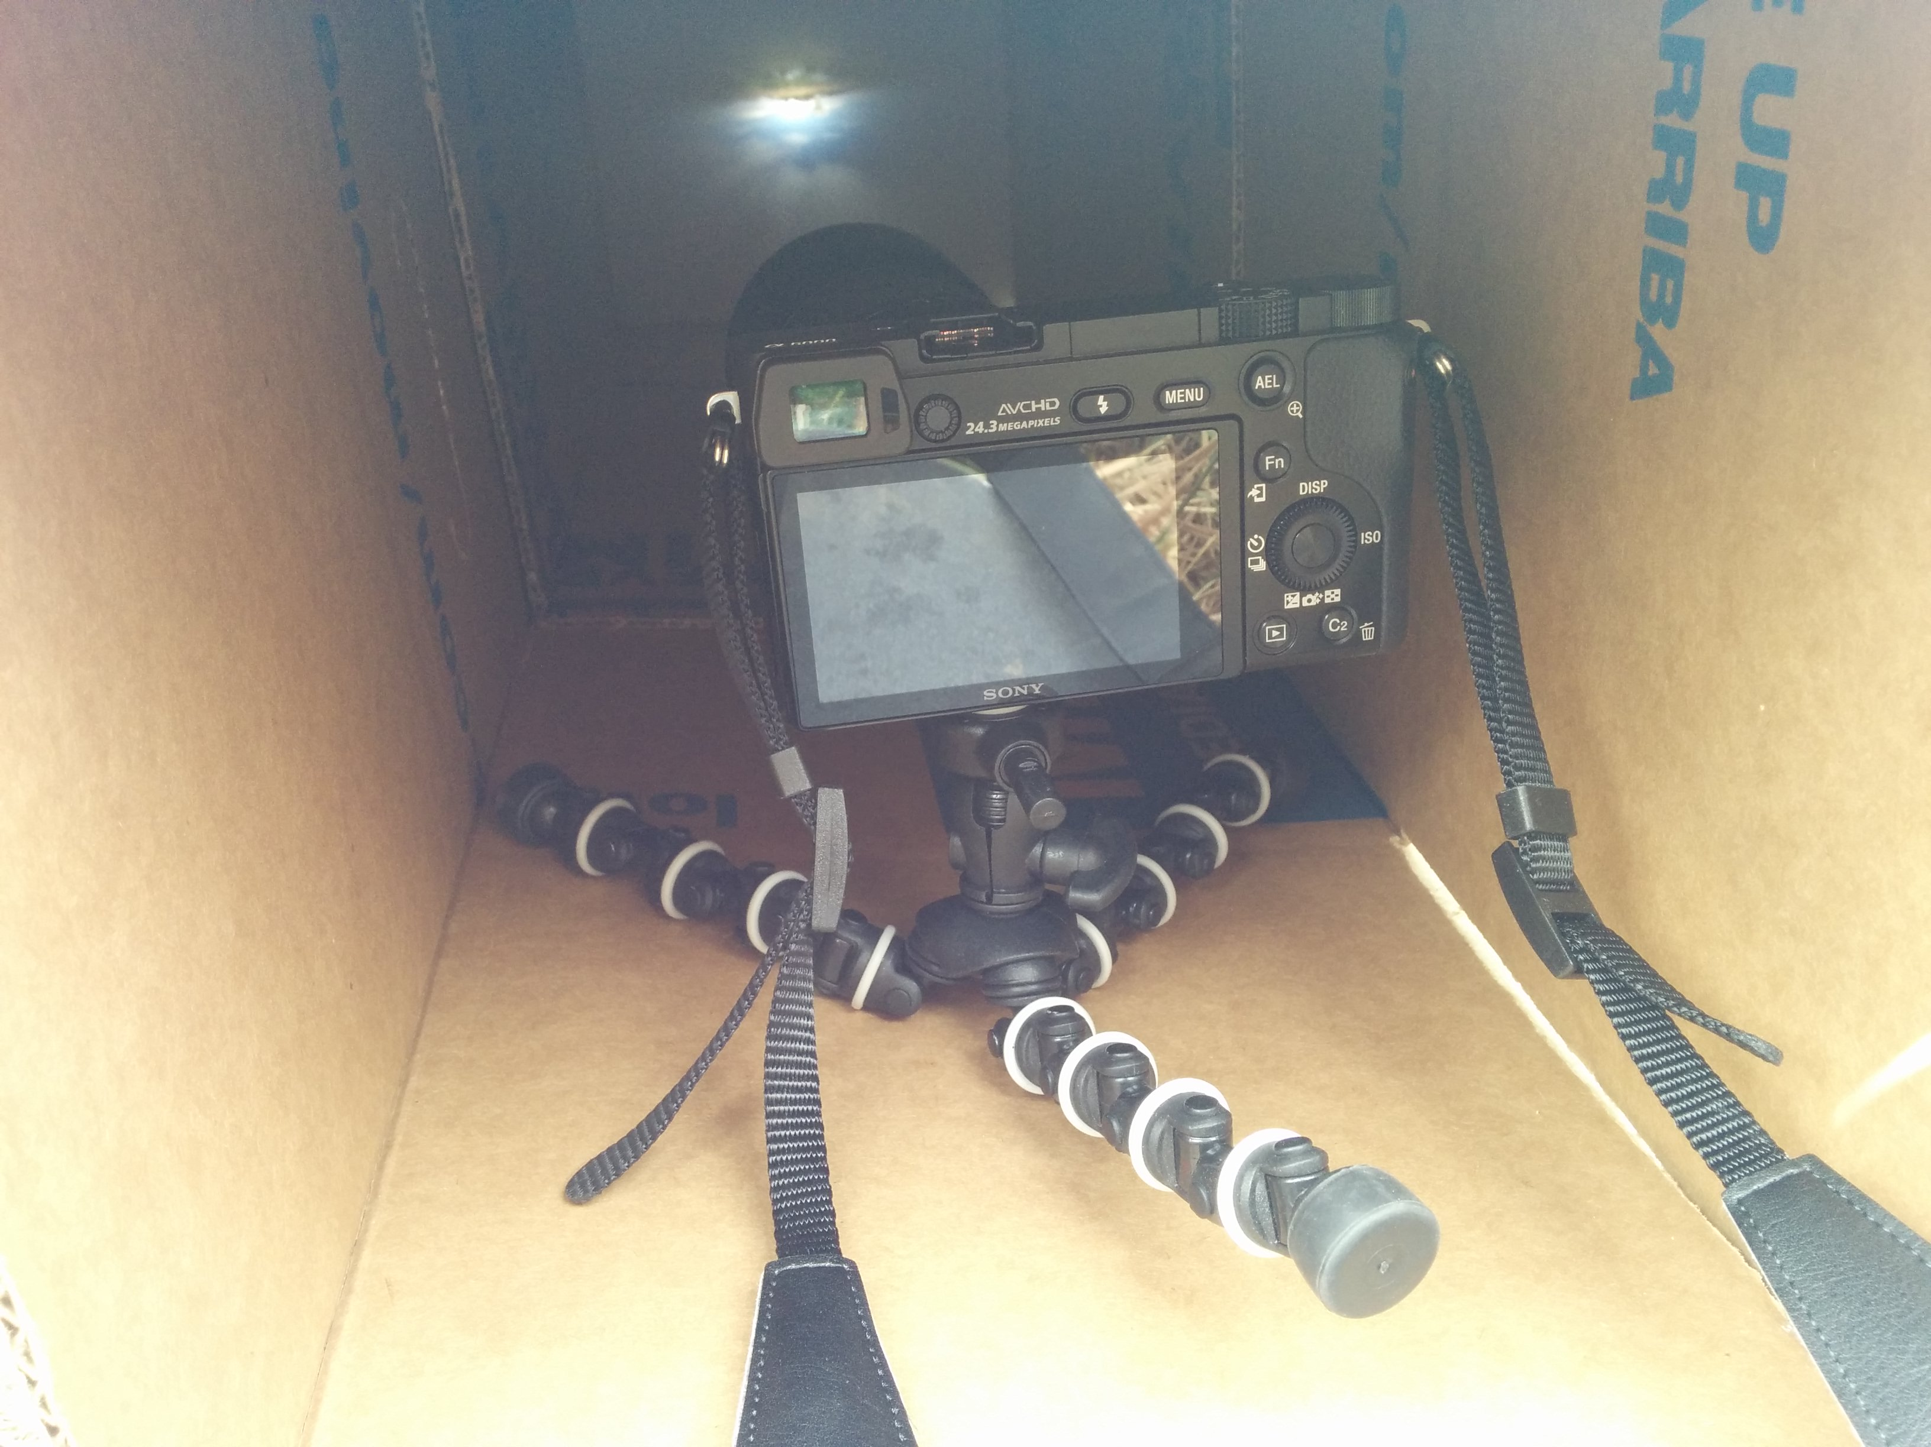
Assignment #5: Camera Obscura
Scene
Resulting Image
Setup

Slide 7
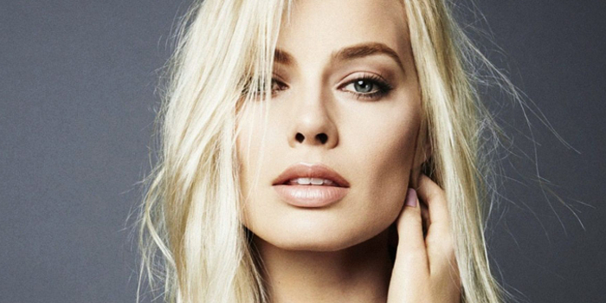



Assignment #6: Blending
White Input
Mask
Black Input
Blended Output

Slide 8
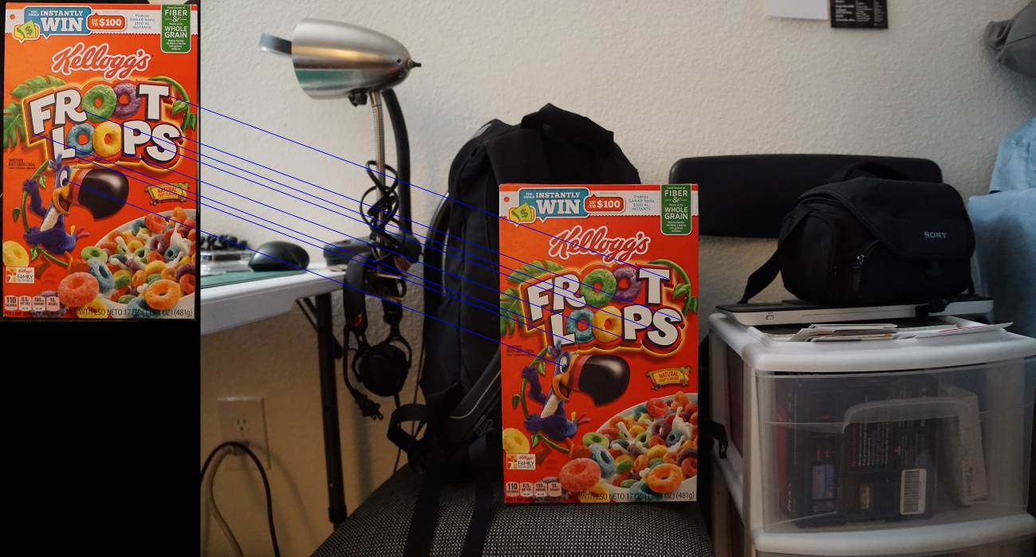
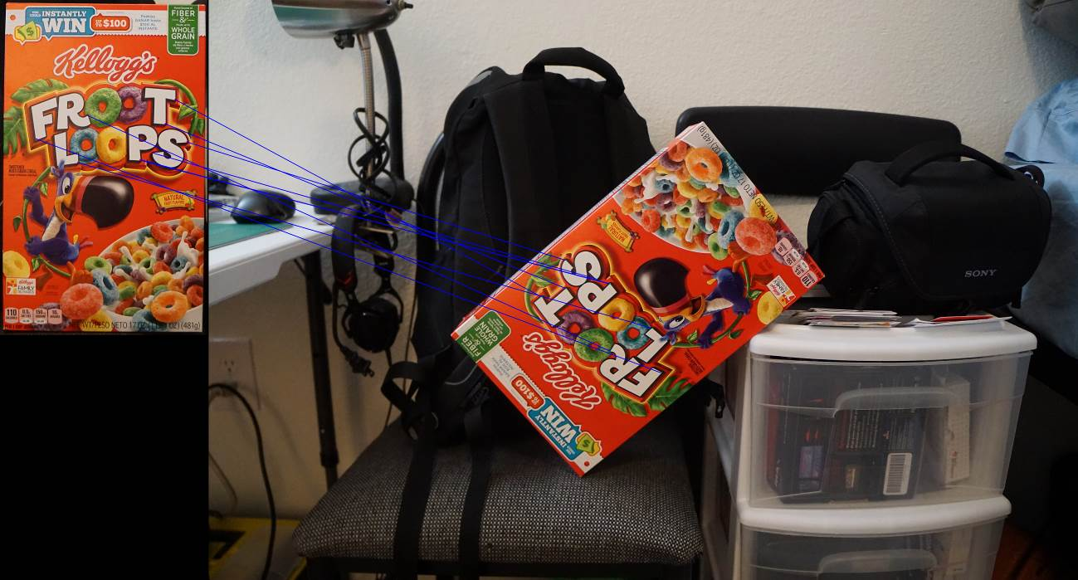
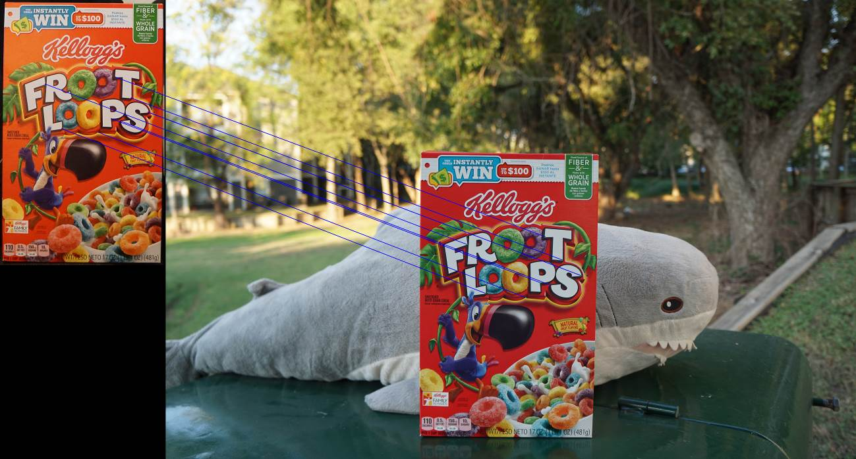
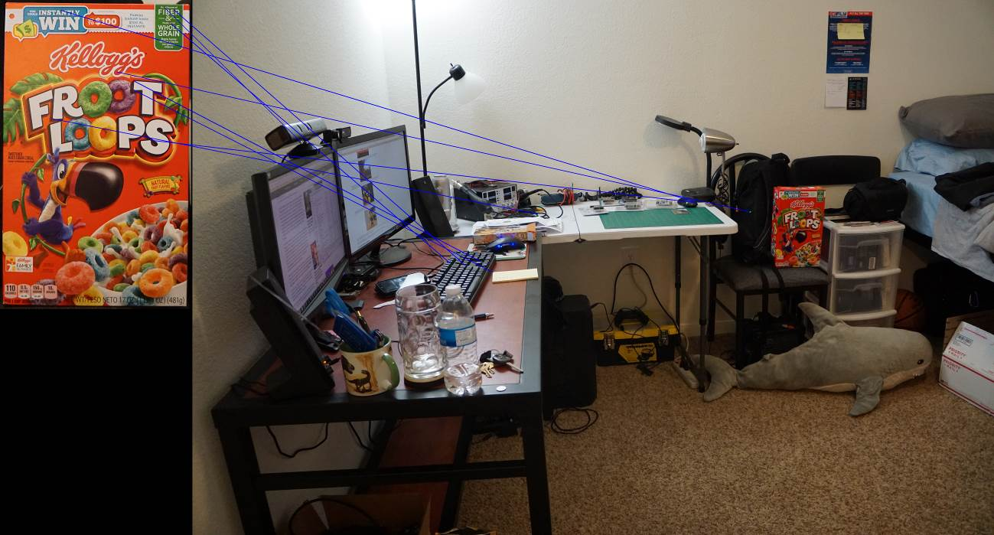
Assignment #7: Feature Detection
Indoor
Rotation
Outdoor
Far

Slide 9
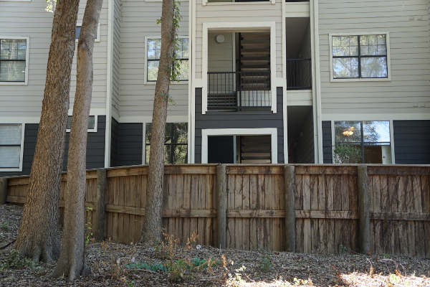
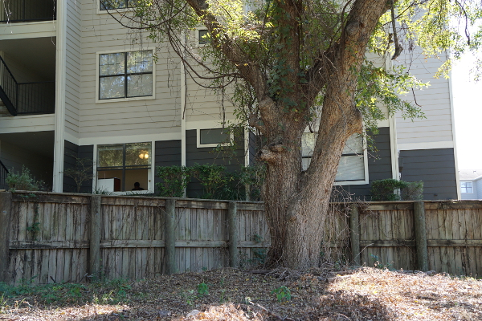
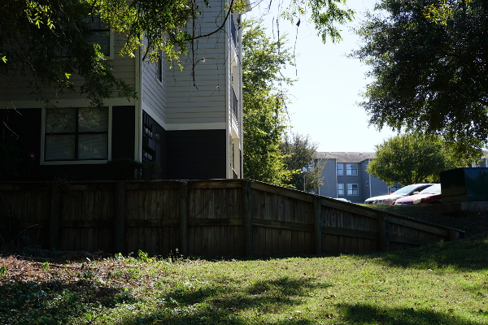
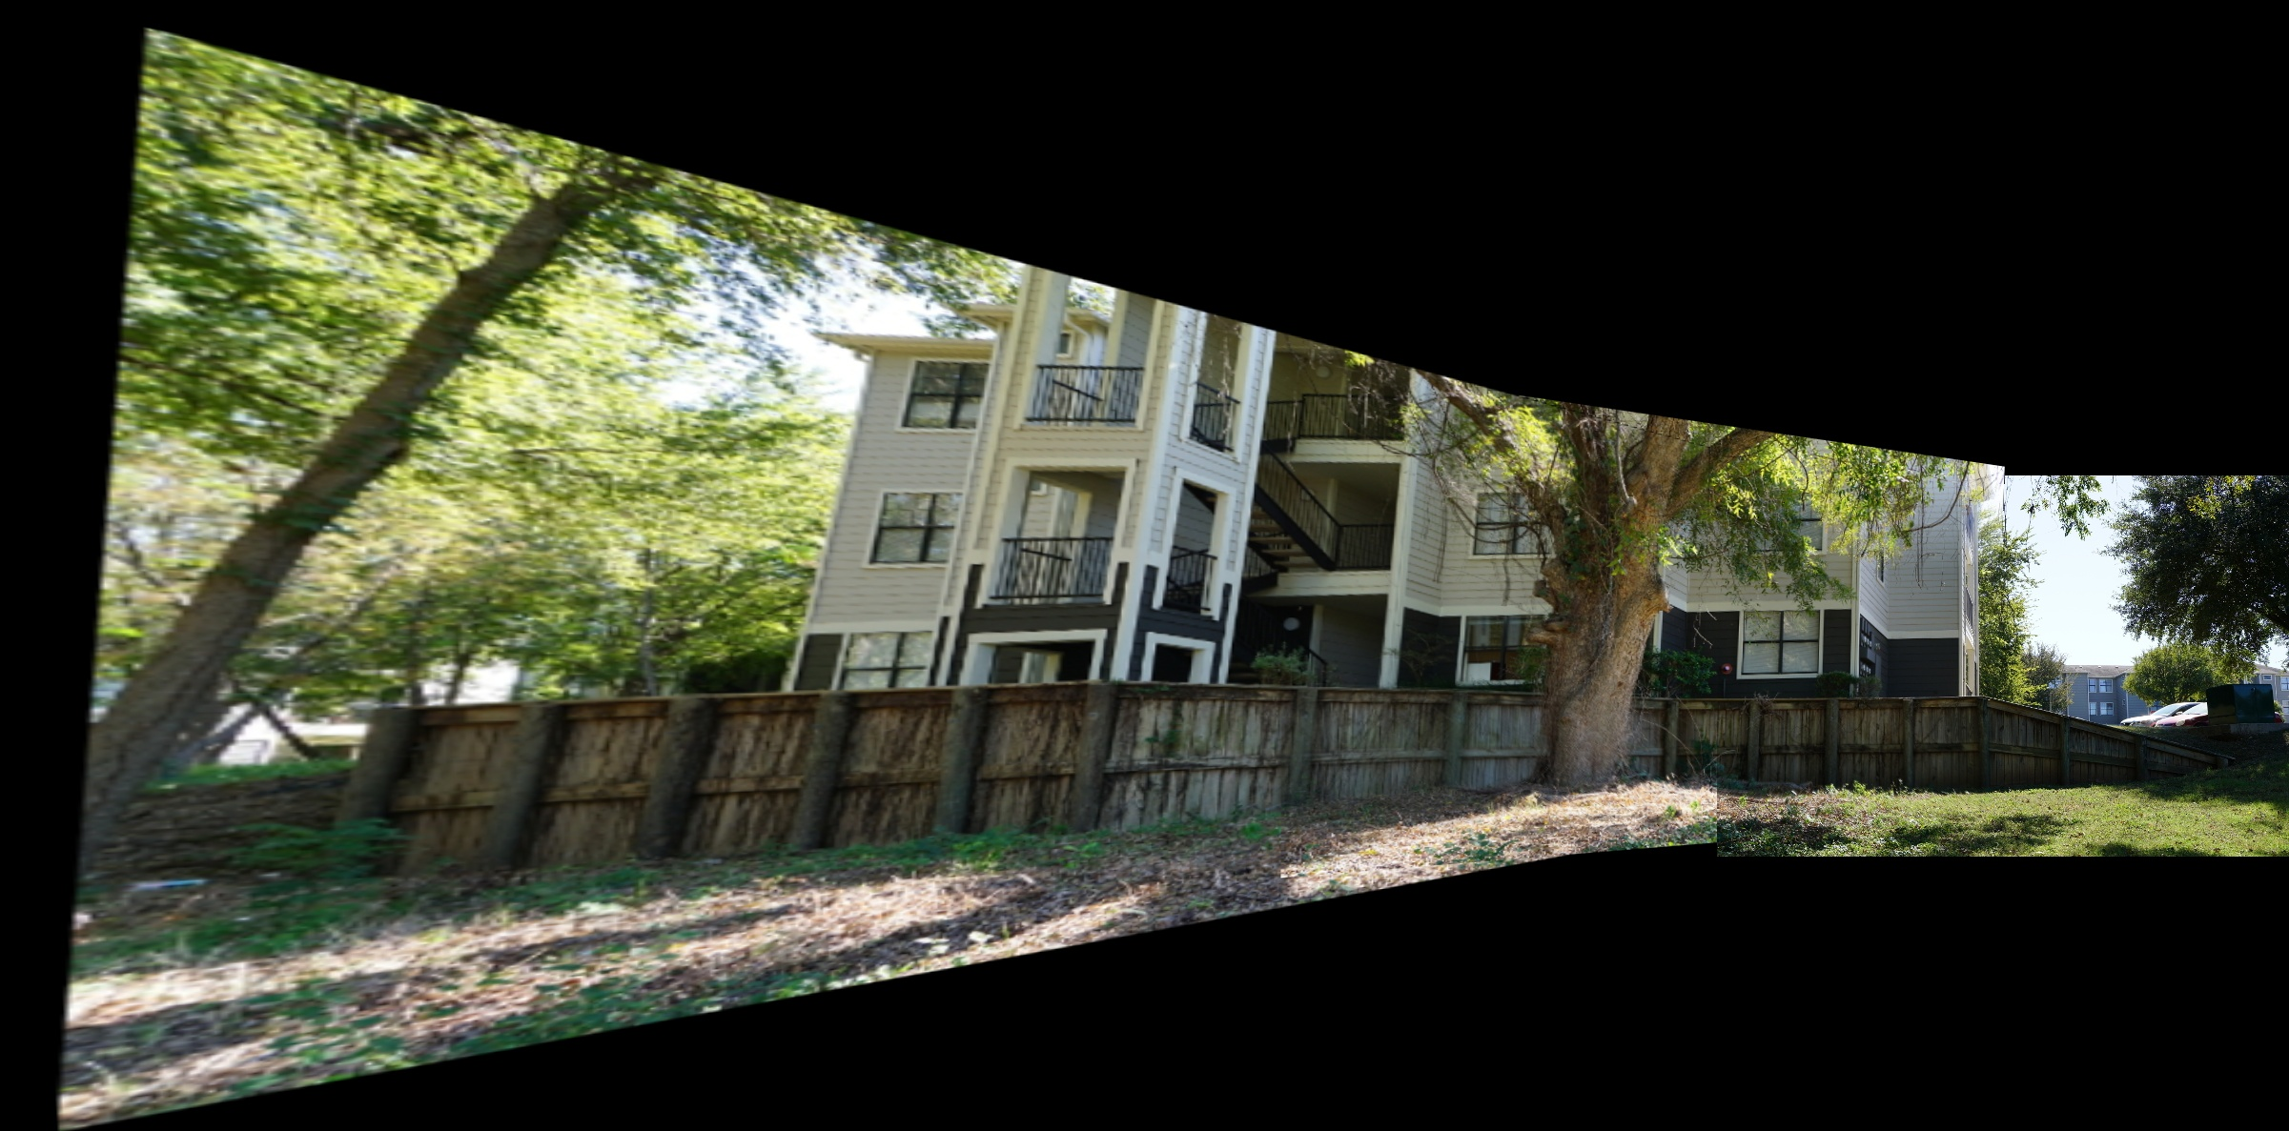
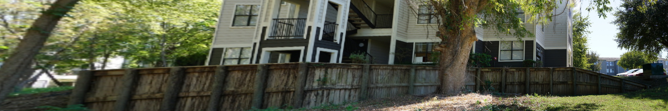
Assignment #8: Panoramas
Inputs
Stitched Panorama
Cropped Panorama

Slide 10
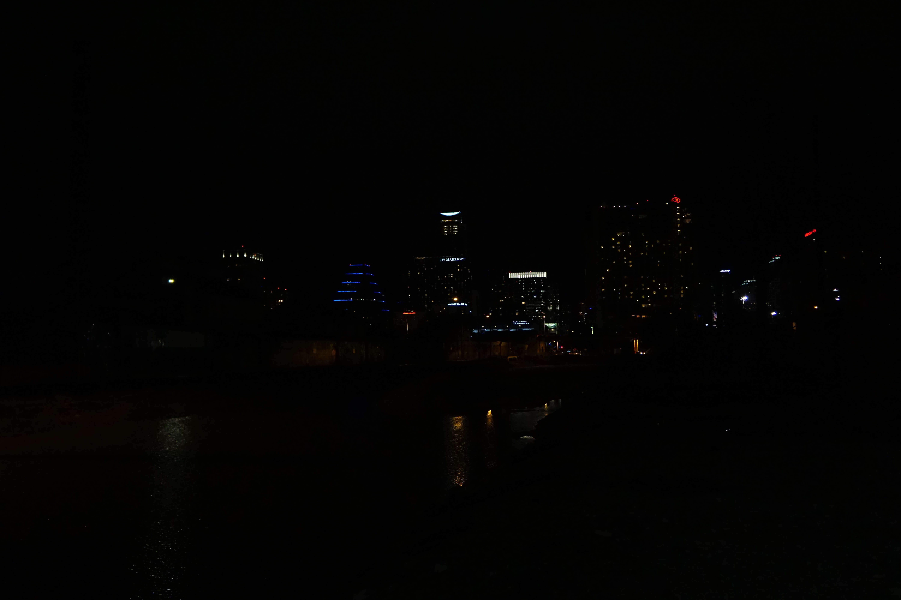
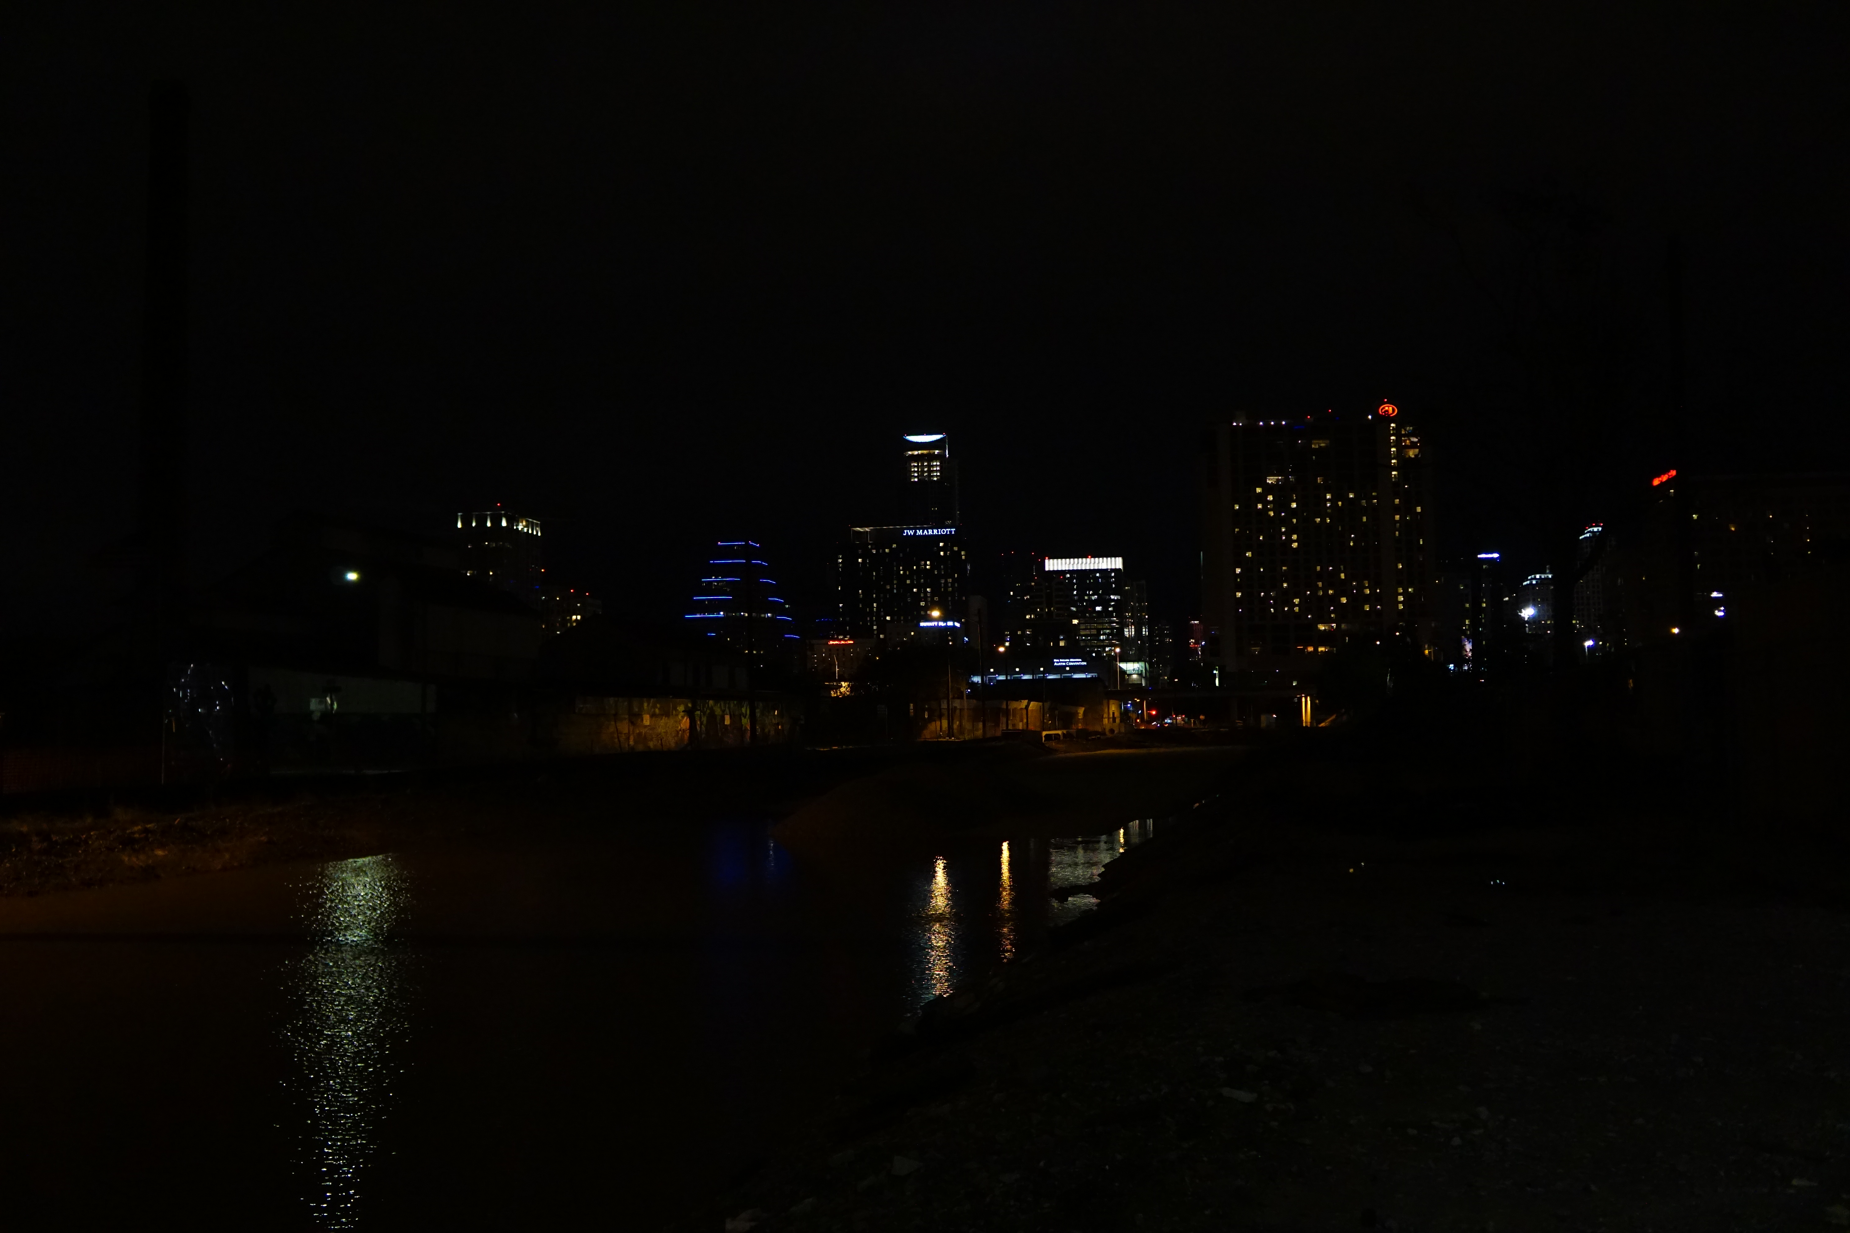
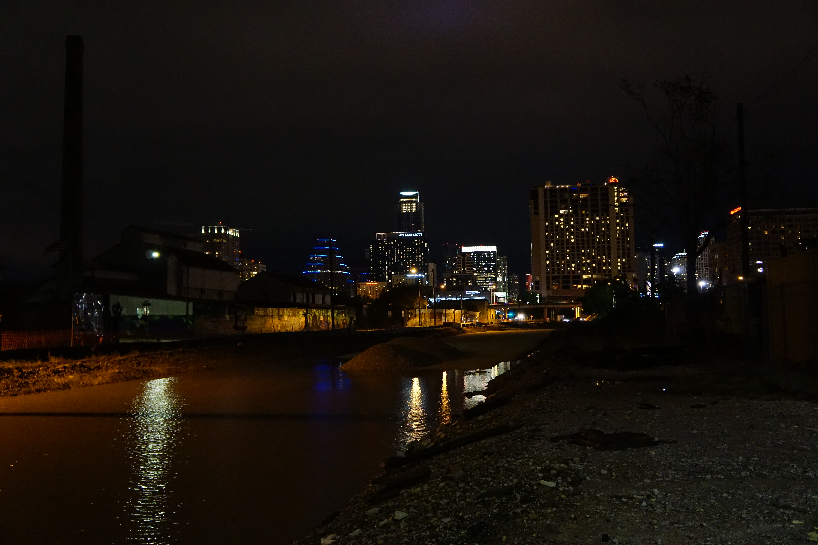
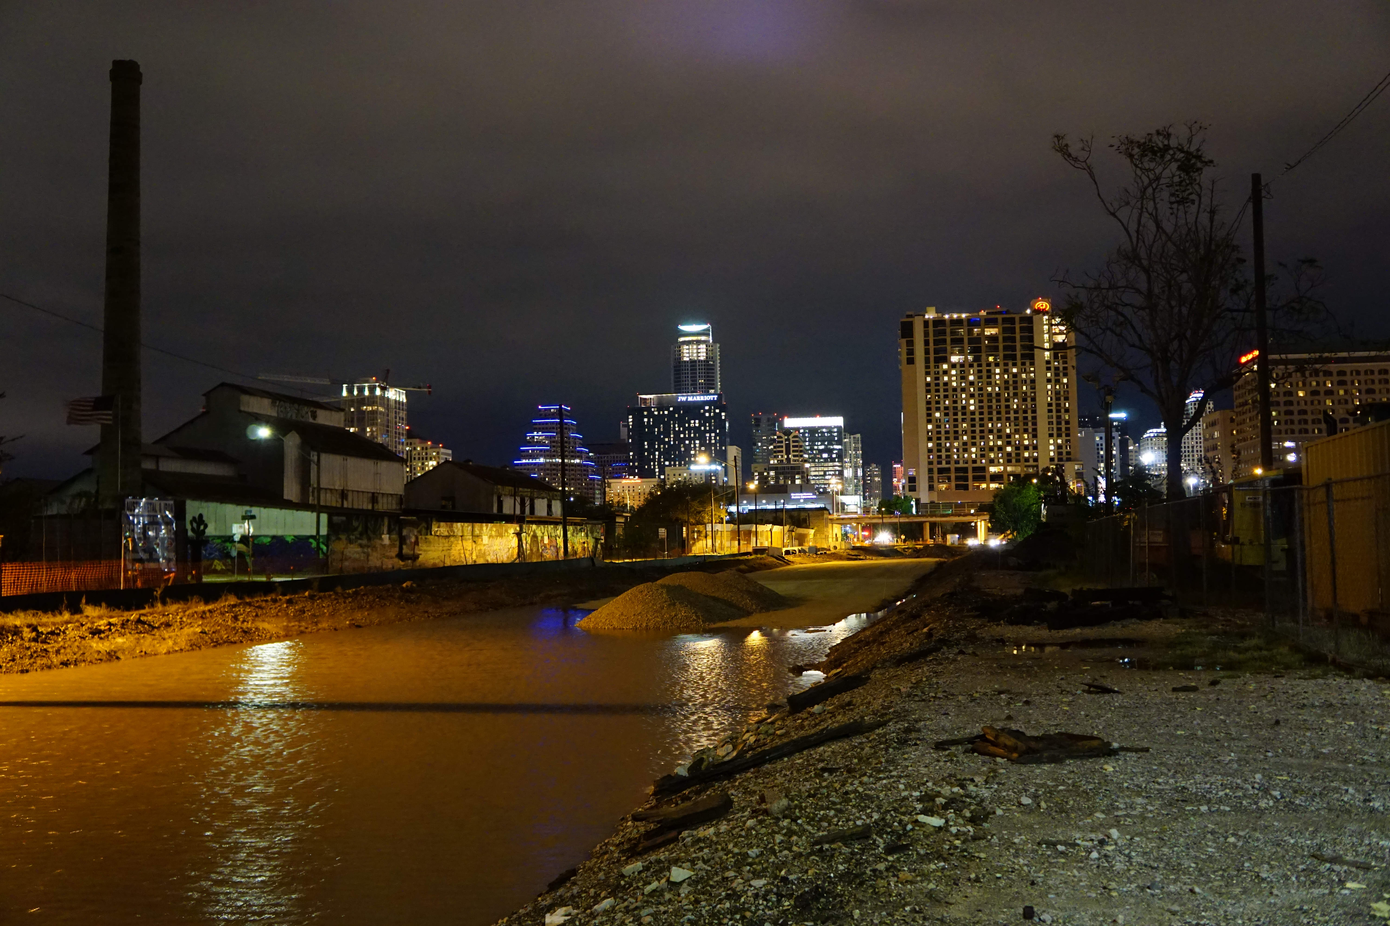
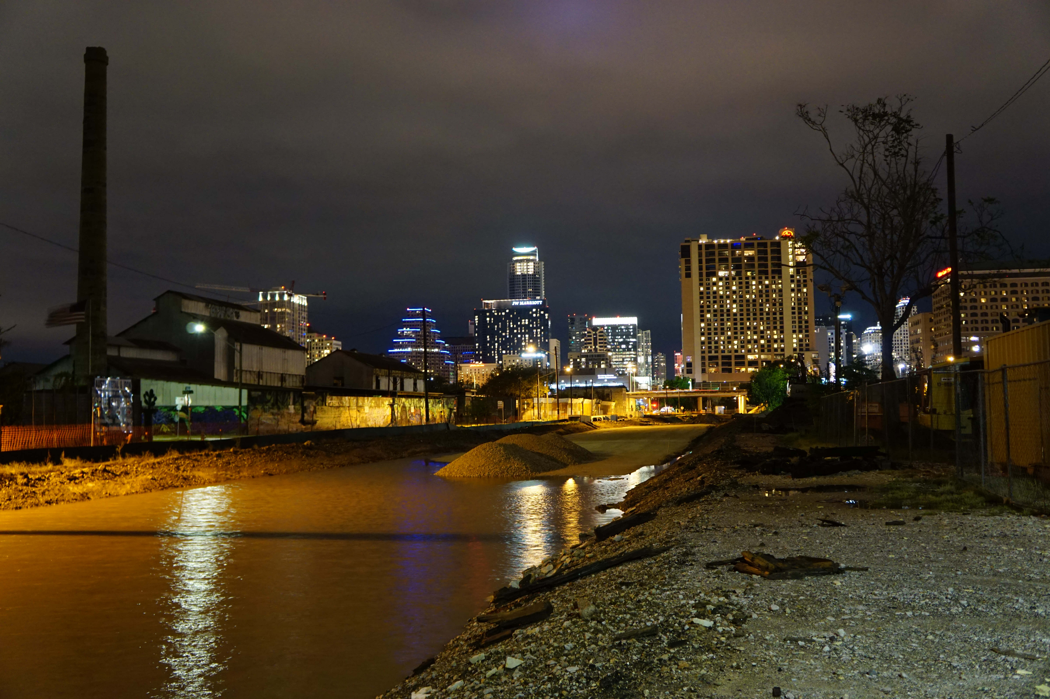
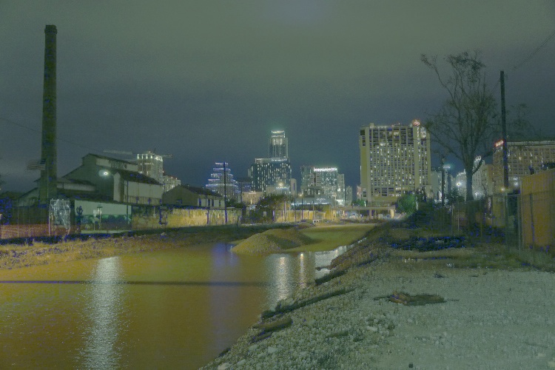
Assignment #9: HDR
Input Images with varying shutter speeds
1/125
1/50
1/15
1/5
1/2
High Dynamic Range Output

Slide 11
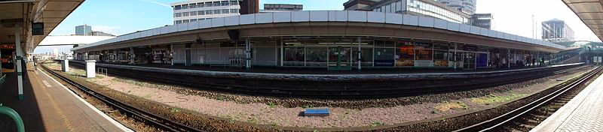
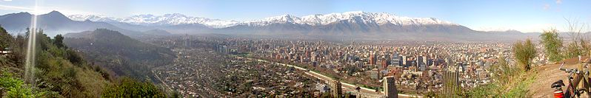
Assignment #10: Pictures of Space (1)
Panorama 1, # of Pictures. Software USED
Panorama 2, # of Pictures. Software USED

Slide 12
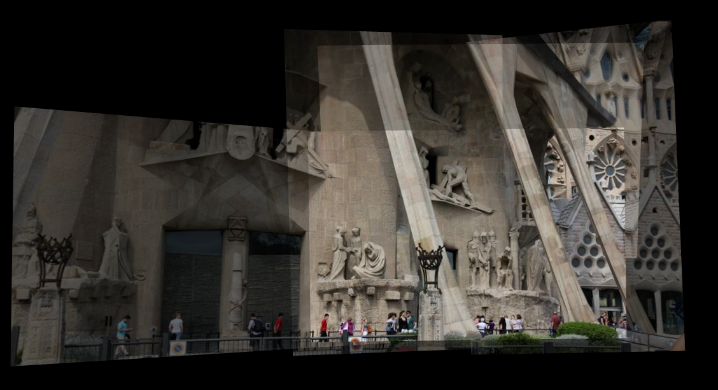
Assignment #10: Pictures of Space (2)
La Sagrada Famillia, http://photosynth.net/view.aspx?cid=9dfb7eb7-a389-4096-93fa-aa19140966cd
Synthy100%
Photos39

Slide 13
Assignment #11: Video Textures
Show the Results from Video Texture Assignment
Feel free to add links to other sites

Slide 14
Final Project
Details about the project, the goals and the team. Use figures as appropriate.

Slide 15
Final Project (2)
Show Before and After Images.

